Slide 1
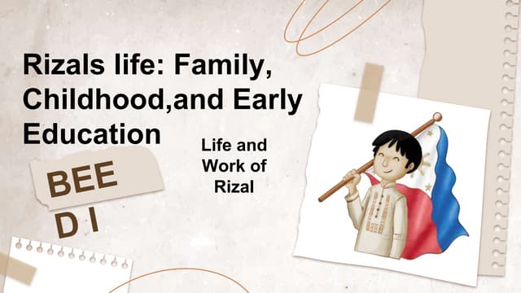

Slide 2
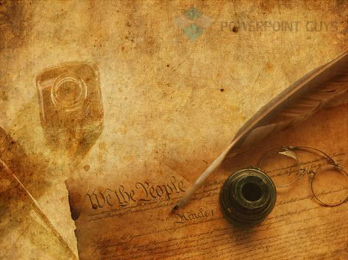
Introduction:

Slide 3
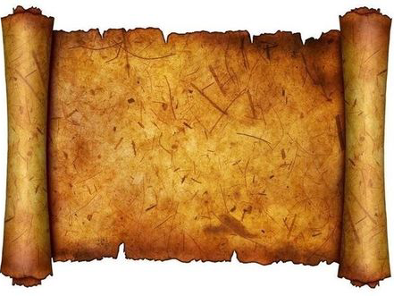
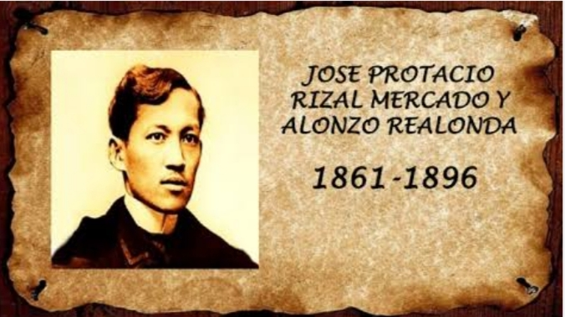
Jose rizal personal info
Jose Protacio Rizal Mercado y Alonzo Realonda was born on june 19,1861 in calamba, Laguna. He was the seventh of eleven children of Francisco Mercado And Teodora Alonso. Jose Rizal is a national hero of the Philippines. He was a writer, poet, and polymath who played a key role in the Philippine Revolution against Spanish colonial rule in the late 19th century.

Slide 4
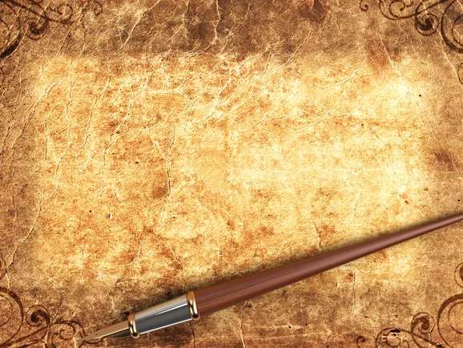
TOPIC 2: Rizal's Family

Slide 5
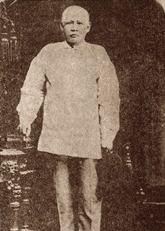
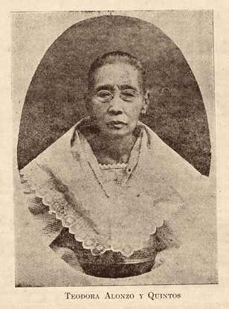
*Jose rizal's Parents *
FRANCISCO MERCADO (1818-1898)
Father of Jose Rizal who was the youngest of 13 offsprings of Juan and Cirila Mercado. Born in Biñan, Laguna on April 18, 1818; studied in San Jose College, Manila; and died in Manila
Teodora Alonso was a highly-educated woman who was known for her intelligence and strong will. She was an active member of the La Liga Filipina, a civic organization that aimed to unite Filipinos and promote reforms. She was born in Santa Cruz, Manila on November 14, 1827 and died in 1913 in Manila.

Slide 6
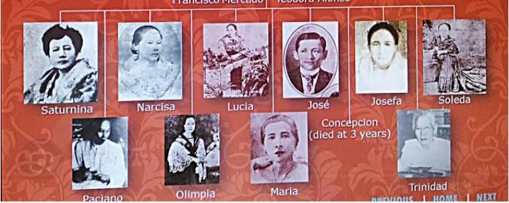
*Siblings of Jose Rizal*

Slide 7
TOPIC 3: Rizal's Childhood

Slide 8
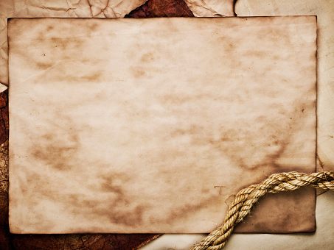
Rizal learned to read and write at a young age under the guidance of his mother, who was a skilled teacher. He showed exceptional intelligence and talent and was able to read and write in both Tagalog and Spanish by the age of five.
- Rizal's parents hired a private tutor named Leon Monroy to teach him more advanced subjects. Monroy recognized Rizal's exceptional abilities and encouraged him to pursue his studies further.
- At the age of 11, Rizal was sent to Biñan to study under Justiniano Aquino Cruz, a strict and demanding teacher who prepared him for entrance exams at the Ateneo Municipal de Manila.
Rizal's childhood was not without its challenges, however. His family faced financial difficulties at times, and he witnessed firsthand the injustices and abuses of Spanish colonial rule in the Philippines

Slide 9
-Nonetheless, Rizal's childhood provided him with a strong foundation for his later achievements as a writer, poet, polymath, and advocate for Philippine independence. His parents' emphasis on education and their support for his talents helped him to become one of the most important figures in Philippine history.

Slide 10
TOPIC 4:
Early Education

Slide 11
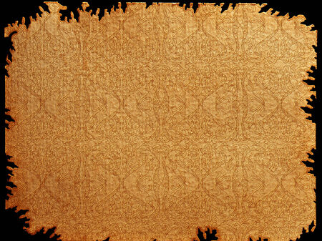
Jose Rizal, the national hero of the Philippines, began his early education in his hometown of Calamba, Laguna. He was taught by his mother, Teodora Alonzo, who was a highly educated woman. Later, he continued his education in Binan, Laguna, where he studied under the guidance of Justiniano Aquino Cruz, a tutor.
In 1872, Rizal went to Manila to attend the Ateneo Municipal de Manila, a prestigious Jesuit-run school. He excelled in his studies and was known for his intelligence and proficiency in various subjects. Rizal's early education played a significant role in shaping his intellectual development and his later efforts to fight for Filipino rights and independence.

